Slide 1
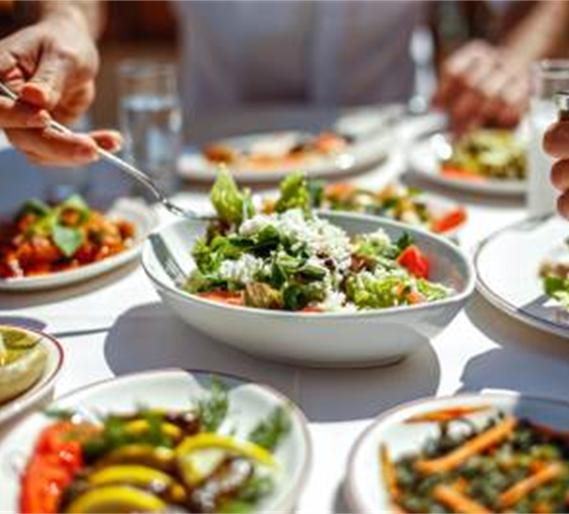
Chefs and Dietitians, a Perfect Pairing
Lisa Eberhart, RD, LDN

Slide 2
The perfect pairing? Really?
Some chefs and dietitians hesitate at the thought of working side by side:
Despite their obvious connection with food and eating.
Despite the shared goal of a happy and safe student experience.

Slide 3
They don’t understand what I go through!
Notes:
It’s common for individuals feel their challenges are not understood by others on the team. A good practice is to be intentional about listening and understanding the circumstances of others to improve the capacity for them to reciprocate by understanding yours.

Slide 4
From the dietitian’s point of view
The dietitian may approach food with a strong academic background and must navigate the abundance of ever-changing research on a healthier diet.
Despite their best intentions, dietitians' practical cooking experience can sometimes be weak, which can decrease their level of effectiveness.
Notes:
Working on your cooking acumen can help your relationship with the culinary staff.

Slide 5
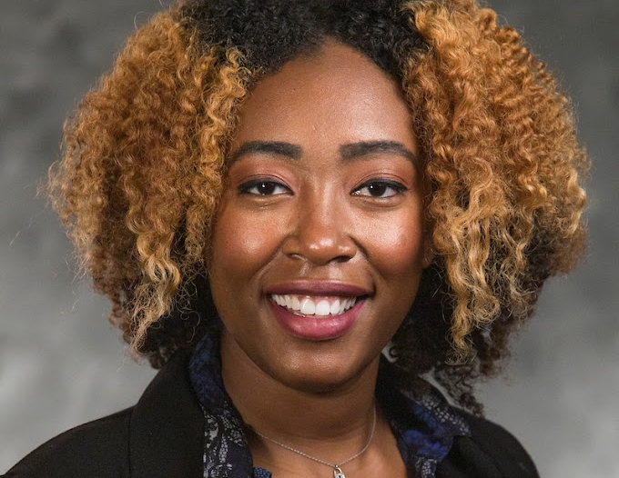
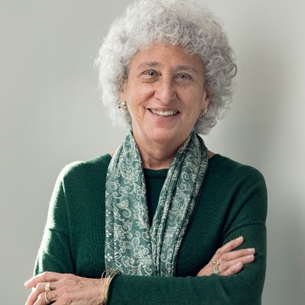
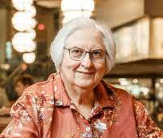
Dietitians You Admire, and Why?
Mary Molt
Jasmine Westbrooks-Figaro
Marion Nestle

Slide 6
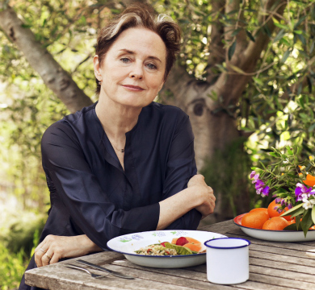
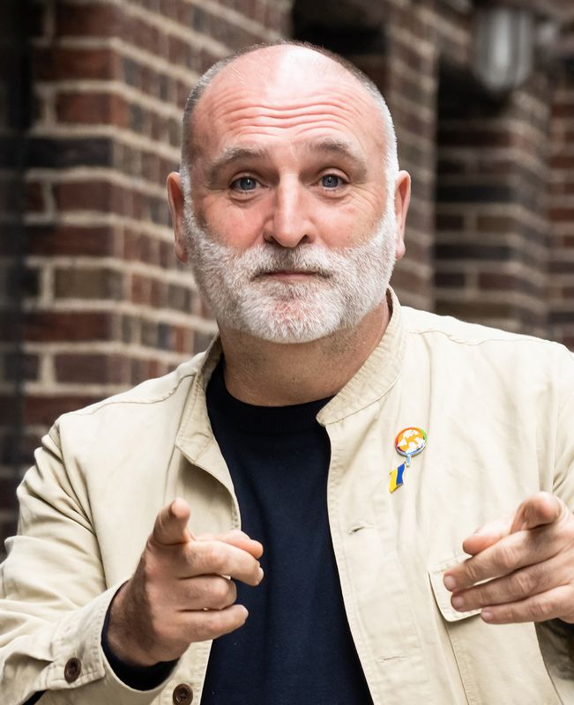
Chefs You Admire, and Why?
Jose Andres
Alice Waters
Ashley Christensen
Notes:
These are some of the chefs I have met or worked with or just plain admire

Slide 7
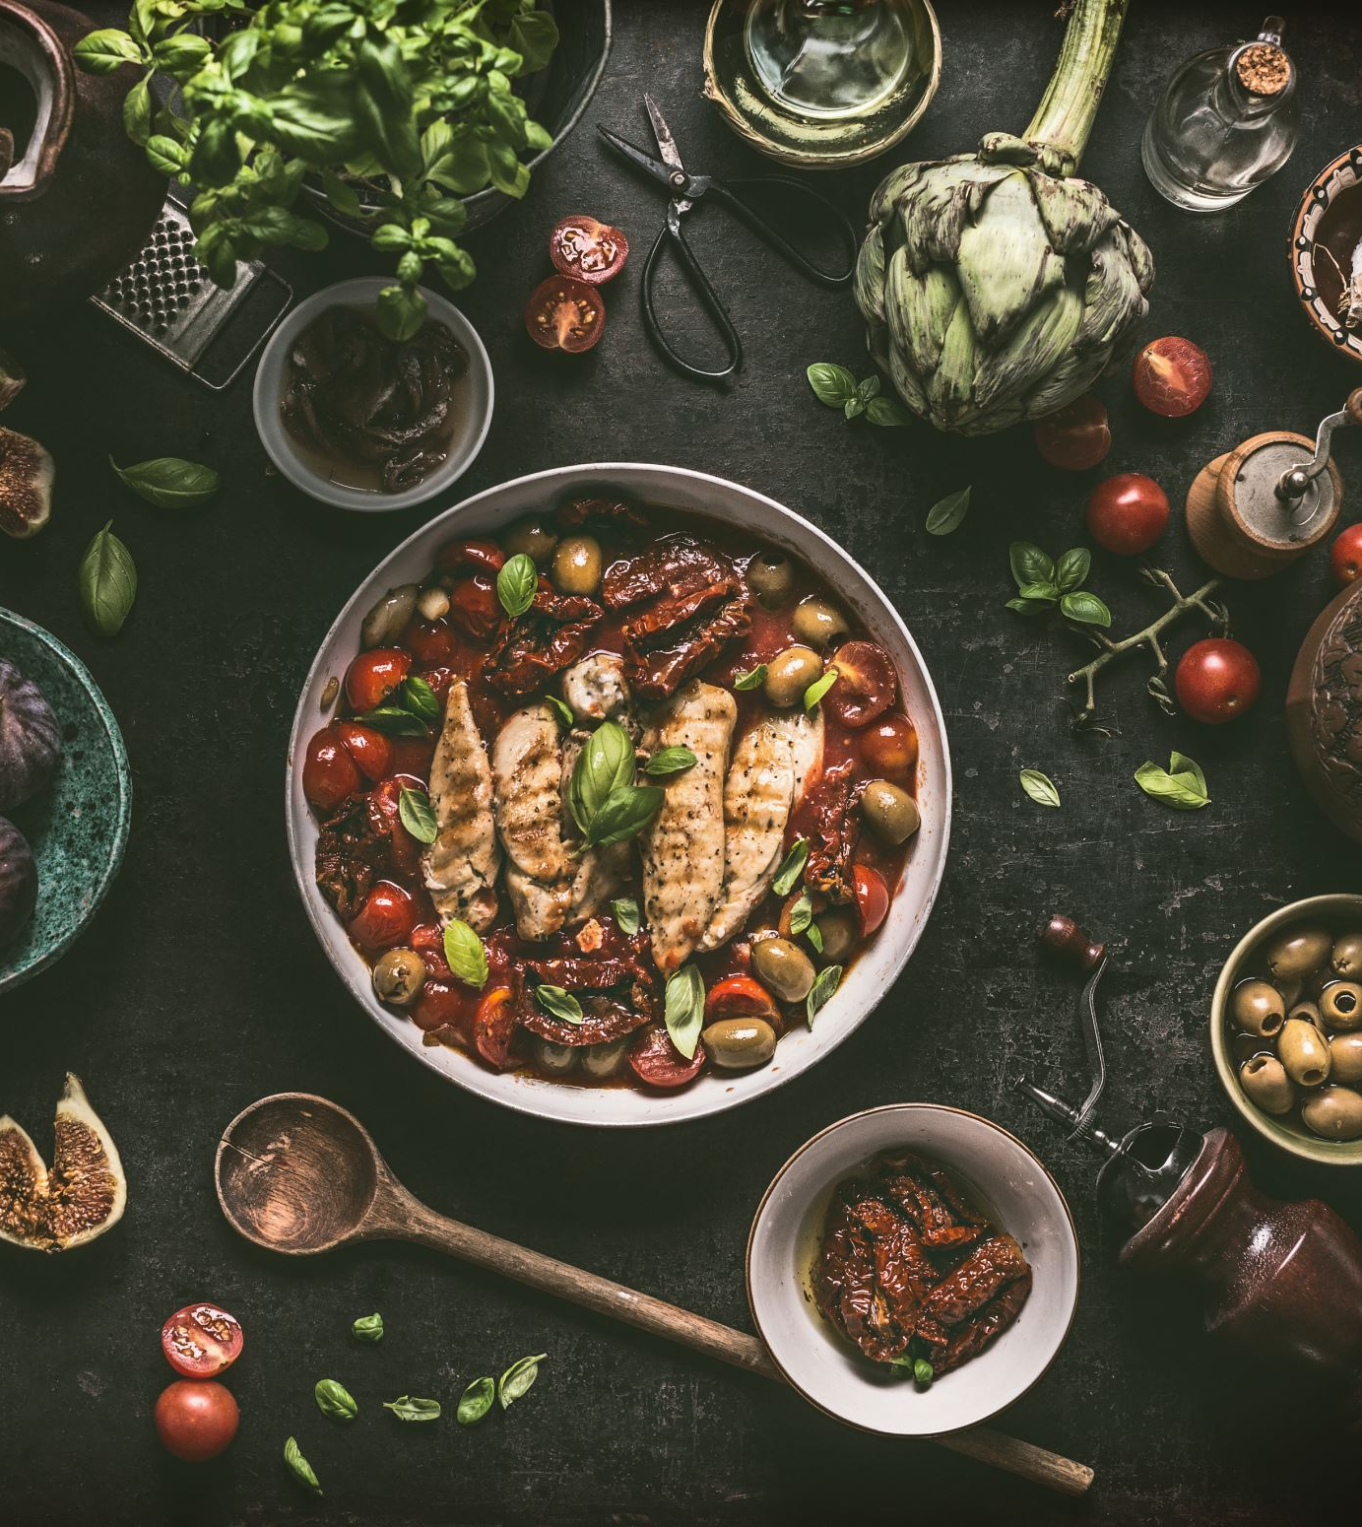
Perhaps there is more in common than you think?
A love of food and appreciation of great food experiences
Winning flavors, aromas, textures
Sustenance that supports student success for all
Dishes that hit ALL the targeted goals

Slide 8
Respecting Different Perspectives
Dietitians
Chefs
Individual needs require focus on the trees more than the forest
Nutrition and wellness are long-term investments that take time to yield dividends
Educating about nutrition and special diets is an ongoing process
Satisfy the group (the forest)
Focus on flavor and quality – most delicious wins every time
Logistics are everything – products, people, timelines, distances
Education adds to the food story, but tasting yields instant happy or not results
Are there ways you can support each other?

Slide 9
What’s Your Approach: Food Police or Nutrition Sherpa?
Notes:
Use your leadership skills to guide others towards departmental goals, and avoid being viewed as a “food hater”.
Make sure you leave your judgement about food at home. Really understand “all foods fit” but all may not fit with certain goals. Approach the chef/dietitian relationship from a food loving lens. Make sure you examine your ideas prejudices and challenge some of them if its an issue.
I always find that it's more about how you ask, rather than what you ask

Slide 10
Support the Overall Objectives
Create student success for all students
Elevate the institution
Elevate the dining program
Teamwork makes the dream work – help each other succeed to benefit the team
Notes:
Make sure the department has clear direction and policy regarding food, nutrition, and special dietary needs. This direction should be a DEPARTMENTAL direction, and not seen as a personal objective to be accepted or rejected based on the views of a single person.

Slide 11
How to work well together
Communication: Helps people understand goals and expectations, and express emotions and feelings
Cooperation: Working together to achieve a shared goal and supporting each other
Coordination: Managing resources, activities, and timelines to achieve the desired outcome
Notes:
Minimize talk of undesirable habits early on….focus on progress being made, the benefits of collaboration.

Slide 12
Get to know the culinary team. Know what makes each person tick. Figure how to get the best out of the team members.
Notes:
Establish yourself in the kitchen. Learn about the production process, equipment, challenges. Teach your craft to the culinary staff, explaining how the body utilizes food, what helps, what problems exist from nutrition standpoint……food allergies, religious diets, cardiac, diabetes, long term impacts of poor nutrition.
Its important to have an admiration and respect for the role a chef, or the culinary staff in general, play in getting delicious food on the table.

Slide 13
Make sure your communication style includes active listening. Show respect for others’ point of view.

Slide 14
Communicate your departmental goals and how they align with the project/ menu goals.
Notes:
Always start the discussion with what you are fixing and how that will positively impact DEPARTMENTAL GOALS, such as student satisfaction and possibly sales.
Make sure you have done your homework and make sure the ask is doable, affordable and high impact.

Slide 15
The benefits of cooperation
Working as a team allows you to specialize and to focus on one aspect of a project, ensuring that the entire project will be more successful as a result.
Things that grow together, go together: A common saying in food pairings that speaks to seasonality and location.
Working collaboratively on a shared goal has the same outcome.
15
Notes:
Things that grow together, go together: A common saying in food pairings that speaks to seasonality and location.
Make sure you spend time looking for the shared goals and work on those first. Everyone feels more valued if they think their needs and aspirations are being valued.
After you develop that good respectful working relationship, work together on your goals.

Slide 16
Cooperation
Dietitians should be learning more about food production to help support the process.
Chefs and dietitians together create flavorful cuisine that can also be healthy.

Slide 17
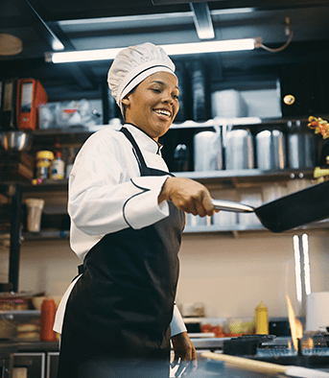
Spend time in the kitchen!
Teach your craft but also learn the crafts of the culinary team to strengthen your knowledge and build a collaborative and supportive environment.
Watch the trends, read industry publications geared at chefs.
Follow chef/dietitians and dietitians that do lots of cooking demos. Attend and assist with some.
Notes:
build a stronger overall knowledge of core ingredients, how to prepare them, and how to recognize the ways in which they can be manipulated. Cooking also gives dietitians more experience seasoning foods with big flavor, low-calorie pungents and aromatics such as alliums (eg, garlic, shallots, scallions), spices, and citrus zests. These items offer many health benefits and few, if any, negatives. There are some of those chef dietitians and dietitians who do lots of demos here!

Slide 18
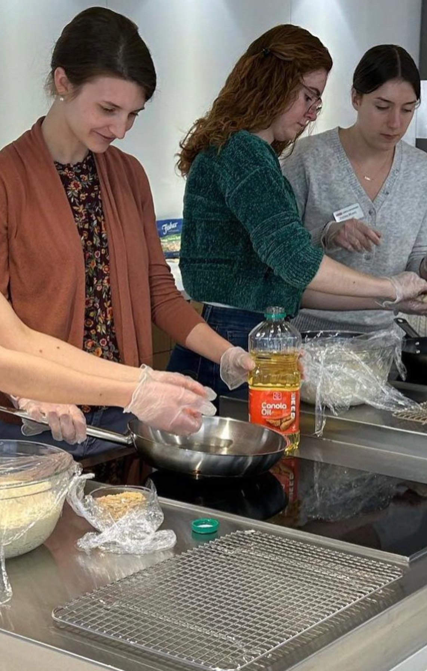
Make sure you are in there cooking, too!
Notes:
Whether with the chefs or with the students. You need to be in there cooking. Be seen as a peer, not an outsider to the culinary team.

Slide 19
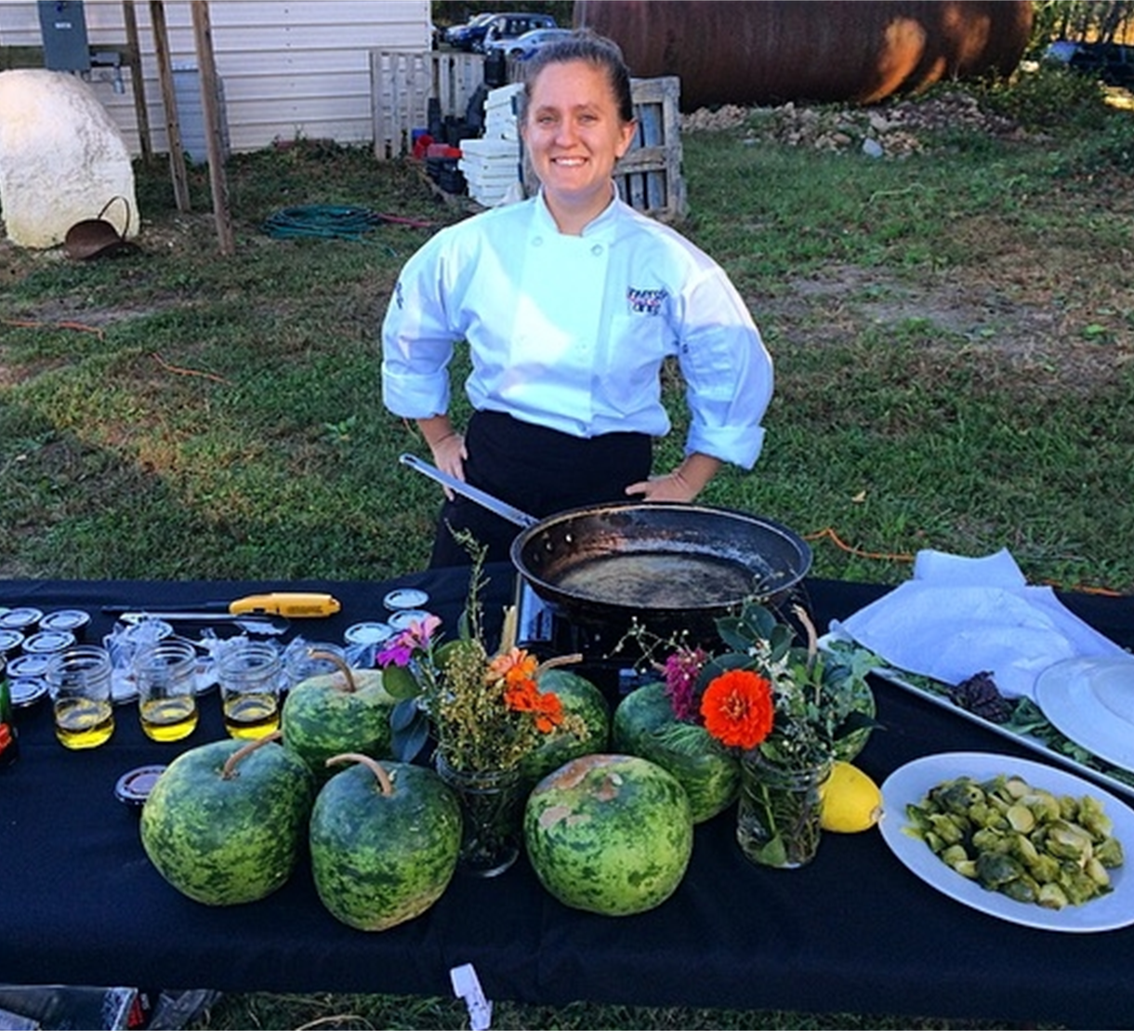
Identify outside influencers who can support special events – bringing fresh perspectives and energy!
Notes:
Find people that can help you get the skills

Slide 20
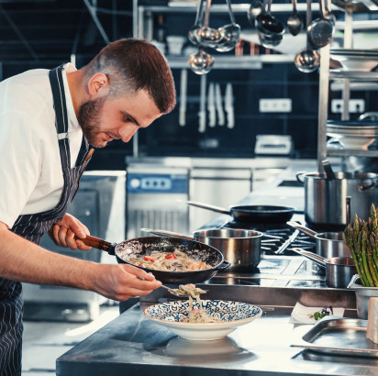
Creativity should be encouraged!
Chefs are creative people. Tap into their creativity to achieve your goals
Notes:
Make sure you come up with realistic and fresh ideas based on a foundation of personal culinary skills you have built.
For the chef this can build their confidence in the dietitian.

Slide 21
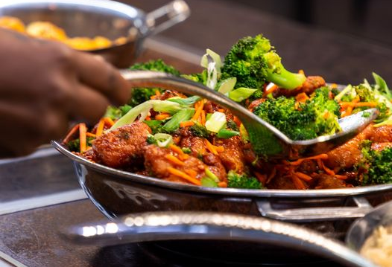
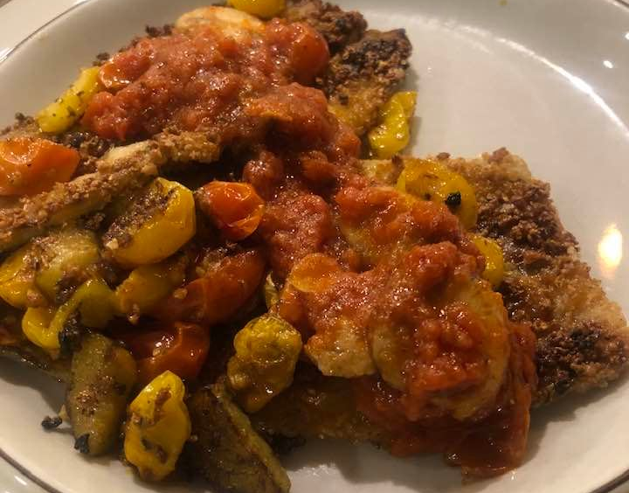
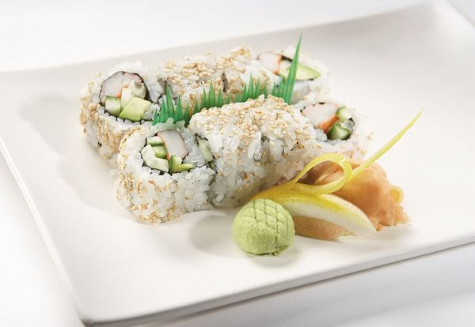
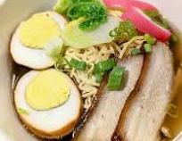
Showcase the results to elevate the team and department
Notes:
Get the word out about your culinary staff. Sing their praises though pictures of the FOOD!
Have your team take good pictures of the healthier items or those that you supported development of. Everyone loves positive press. Everyone needs some praise.

Slide 22
Coordination
This is about managing resources, activities, and timelines to achieve a desired outcome.
Notes:
Time and money
Look at where you want to be with the menu changes and work backwards to develop an achievable timeline.
What are the challenges?

Slide 23
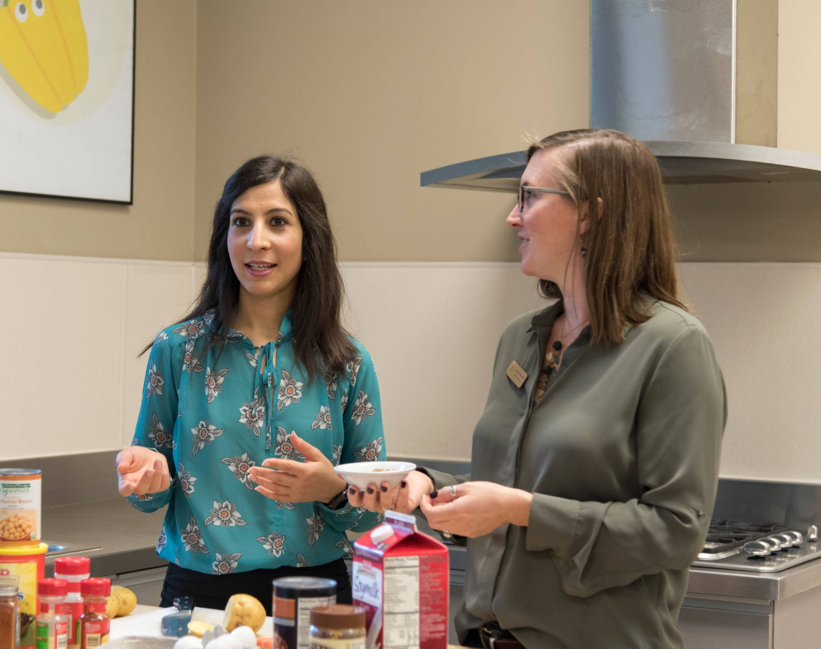
I don’t have time to do all this!
Use your resources!
Notes:
I can feel some of you saying, I just don’t have time. Cooking demos, learning more about food yikes!
Find helpers with similar interests!!!
Use interns use interns use interns. If you don’t have interns use students.
Chefs like to help educate interns and students so let them start cooking and working with the culinary staff be part of their internship

Slide 24
Time is Money!
The chefs don’t have the time, and we don’t have the budget to hire more people!
Notes:
We don’t have the money or bandwidth for our chefs to spend time " building "a relationship with the dietitian. You can bring guest chefs in and have them do the demo. Look to your prime vendor to get guest chefs or even the community.
If you want more vegan recipes on the menu items reach out to Humane society or reach out to local vegan cook book authors or vegan restaurant owners.

Slide 25
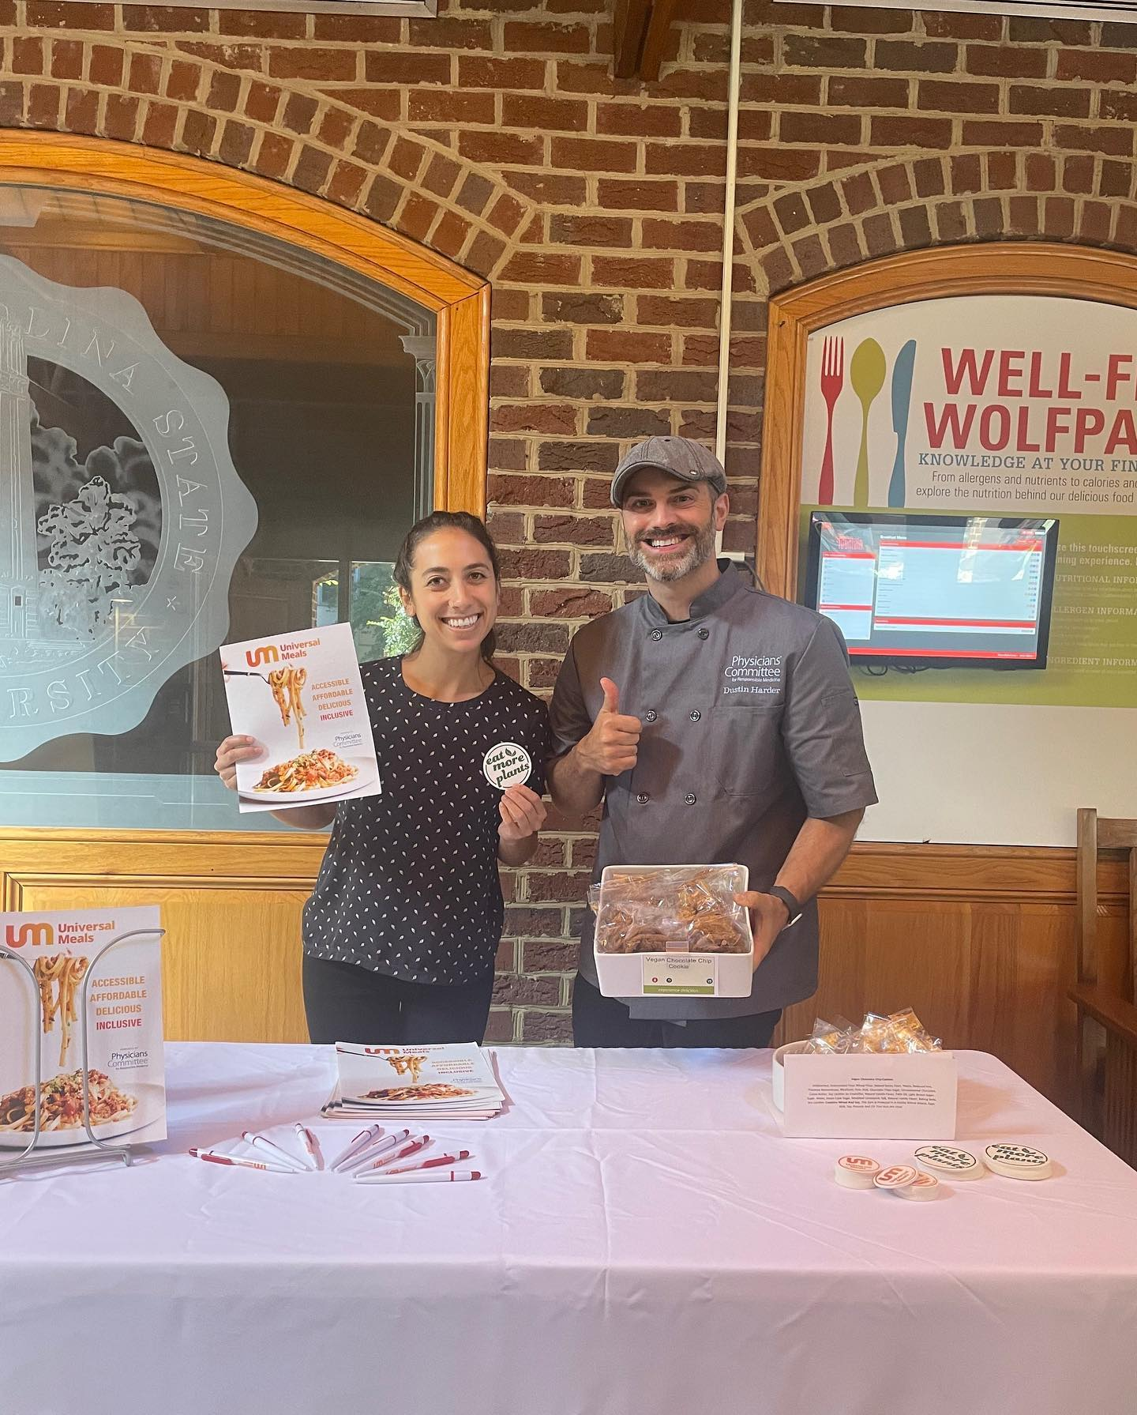
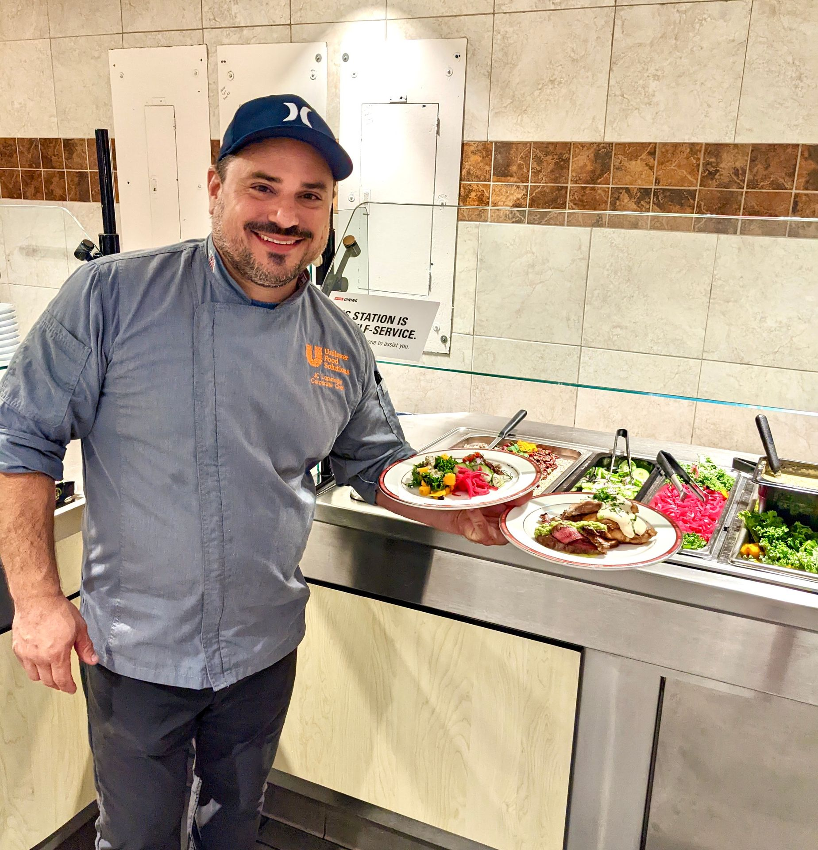
Guest Chefs Are A Great Resource
Notes:
Bring in guest chefs to help with the work and enhance the chefs education on campus. This will align with your goals and give the chefs new ideas and sometimes really decrease their workload.

Slide 26
Help them tell their story and shine.
Notes:
Don’t overlook your own chefs though.
Give your chefs a platform to shine. Some love to cook in front of others. Others just like working with students. See what they enjoy and develop experinces based on that.

Slide 27
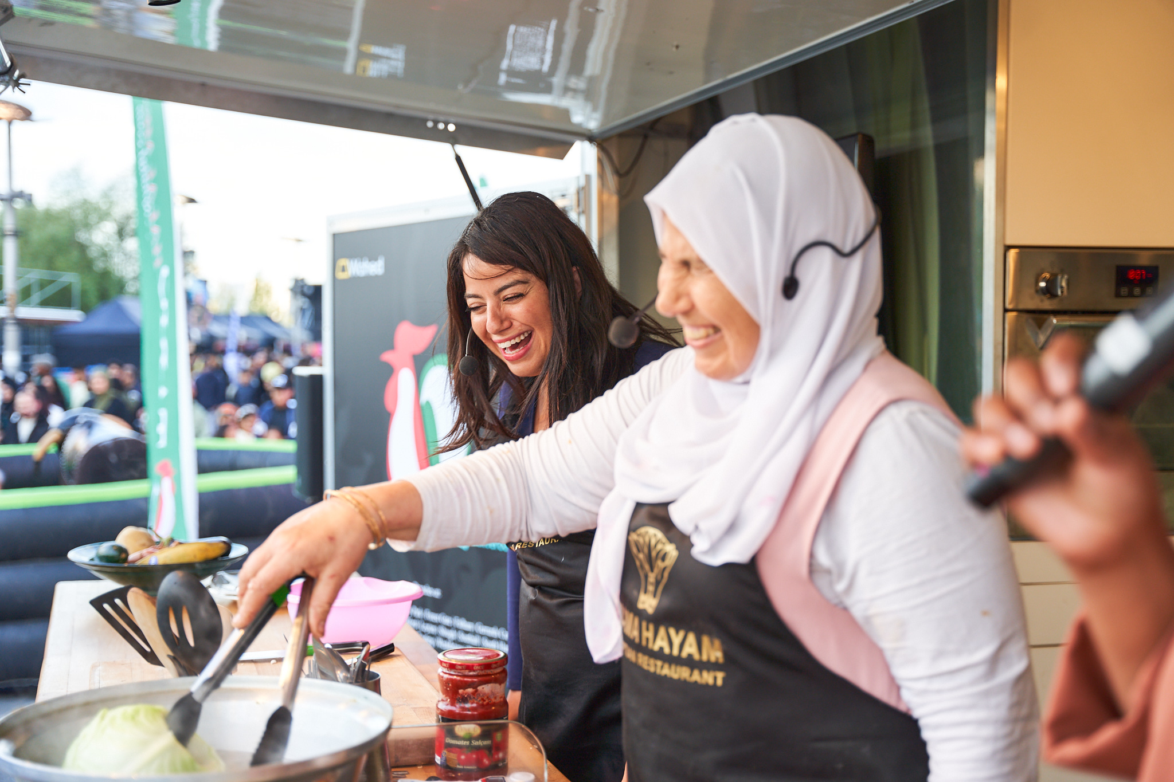
Food Allergies
Religion Based Dietary Needs
Notes:
What better way to build your relationship with the chefs on campus than to involve students in the development of recipes and demos.
You guiding the students and answering questions about nutrition and the chef imparting his knowledge of the food.
This is a great thing to do with the allergy students on campus to develop the rapport between the chef and the students with special dietary needs.
Also great jumping off point for special dietary needs like Halal. Helping the students that follow the Halal diet see that your chef understands the principles and can do a demo that falls inline with their religious beliefs.

Slide 28
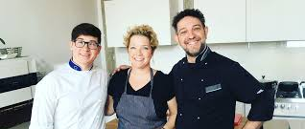
What ideas you have used on your campus to develop that dietitian chef relationship?

Slide 29
What can you take back to your campus that will positively impact the chef dietitian relationship?

Slide 30
Start with the basics
Look for support from the director and other leadership. Find culinary/nutrition projects that align with the plans of upper management
01
Build positive and collaborative relationships with the culinary team. Be seen as a resource and an ally.
02
Look for projects that benefit students and elevate the department.
03
Notes:
To recap
Make sure there is overall guidance regarding nutrition and special diets that exists at a departmental level, so that these goals are EVERYONE’S GOALS, and not perceived to be your own personal agenda.
Really pay attention to departmental goals. What is the long term plan for the food service? How can your collaboration with the chef and the overall menu development help you both?

Slide 31
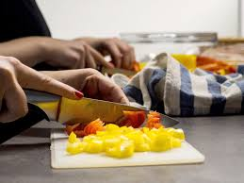
Do Your Homework
Notes:
Get more experience with cooking and follow culinary trends

Slide 32
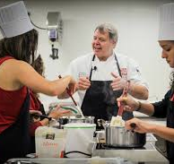
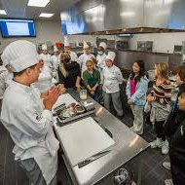
Look for ways to integrate students, unique food experiences, and your culinary staff into the overall culinary experience on campus

Slide 33
Thank you
Lisa Eberhart RD,LDN
Lisa@menuanalytics.com

